Slide 1
Benchmarking SCM namespace with fio

Slide 2
[root@localhost benchmark_script]# /root/anaconda3/bin/python bench_fio --target /dev/pmem0 /dev/pmem0.1 --type device --engine libpmem --loginterval 500 --duration 720 -b 1k 2k 4k 8k 16k 32k 64k 128k 512k 1024k 2048k 4096k --template fio-job-template.fio --iodepth 1 8 16 32 64 128 --numjobs 1 8 16 32 64 --mode randrw --output /home/rahul/MEM_DAX --rwmixread 75 90
███████████████████████████████████████████████████████████████████████████████████
+++ Fio Benchmark Script +++
Estimated duration : 42:00:00
Test target : /dev/pmem0 /dev/pmem0.1
Job template : fio-job-template.fio
I/O Engine : libpmem
Test mode (read/write) : randrw
IOdepth to be tested : 1 8 16 32 64 128
NumJobs to be tested : 1 8 16 32 64
Block size : 1k 2k 4k 8k 16k 32k 64k 128k 512k 1024k 2048k 4096k
Direct I/O : 1
Read/write mix in %% read : 75 90
Time duration per test (s) : 720
Log interval of perf data : 500
Invalidate buffer cache : 1
Target type : device
Output folder : /home/rahul/MEM_DAX
███████████████████████████████████████████████████████████████████████████████████
100% | | - [42:00:00, 00:00:00]
Figure 1: Benchmarking persistent memory with libpmem IO Engine

Slide 3
[root@localhost ~]# cat /etc/redhat-release
Red Hat Enterprise Linux Server release 7.7 (Maipo)
[root@localhost ~]# lscpu
Architecture: x86_64
CPU op-mode(s): 32-bit, 64-bit
Byte Order: Little Endian
CPU(s): 96
On-line CPU(s) list: 0-95
Thread(s) per core: 2
Core(s) per socket: 24
Socket(s): 2
NUMA node(s): 2
Vendor ID: GenuineIntel
CPU family: 6
Model: 85
Model name: Intel(R) Xeon(R) Platinum 8260 CPU @ 2.40GHz
Stepping: 6
CPU MHz: 1485.351
CPU max MHz: 3900.0000
CPU min MHz: 1000.0000
BogoMIPS: 4800.00
Virtualization: VT-x
L1d cache: 32K
L1i cache: 32K
L2 cache: 1024K
L3 cache: 36608K
Figure 2: System configuration

Slide 4
Benchmarking Results

Slide 5
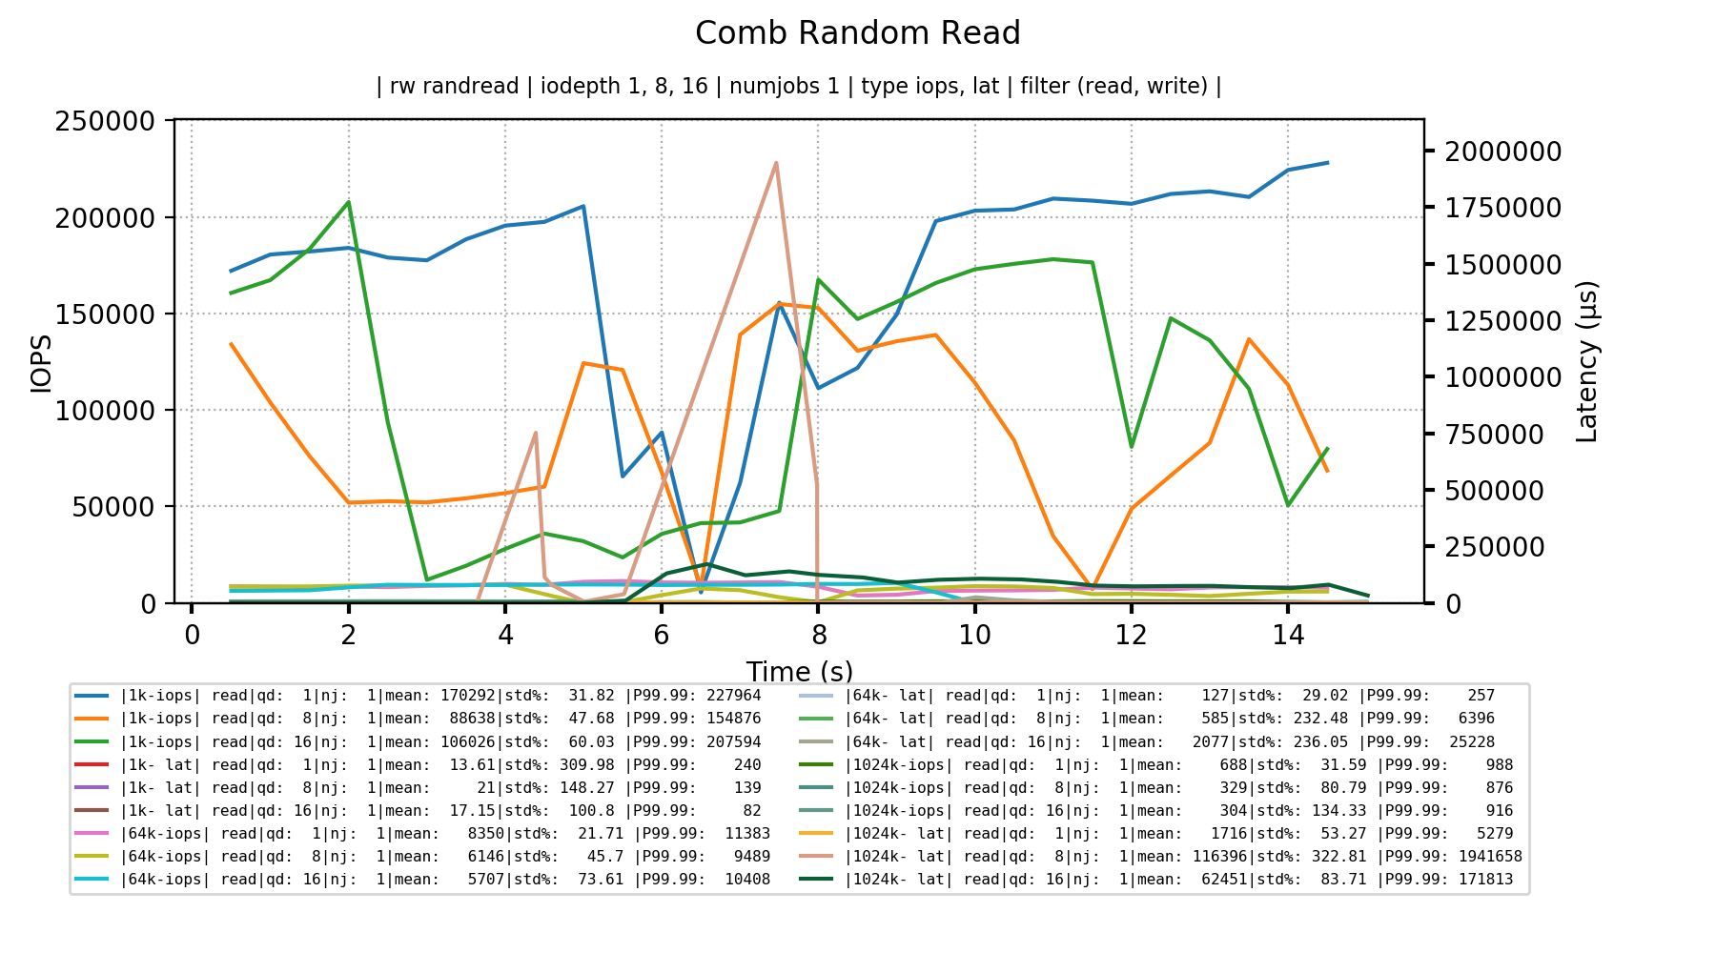
Figure 3: IOPS and Latency benchmarking for 1K, 64K and 1024K

Slide 6
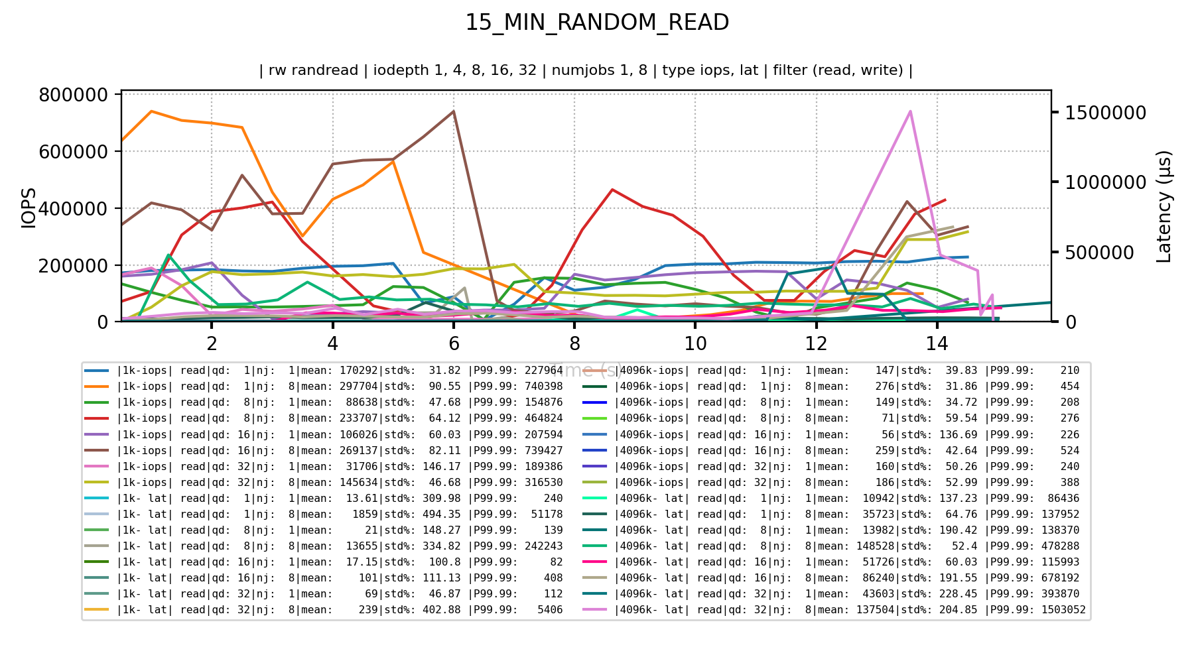
Figure 4: IOPS and Latency benchmarking for 1K and 4096K with various iodepth and jobs

Slide 7
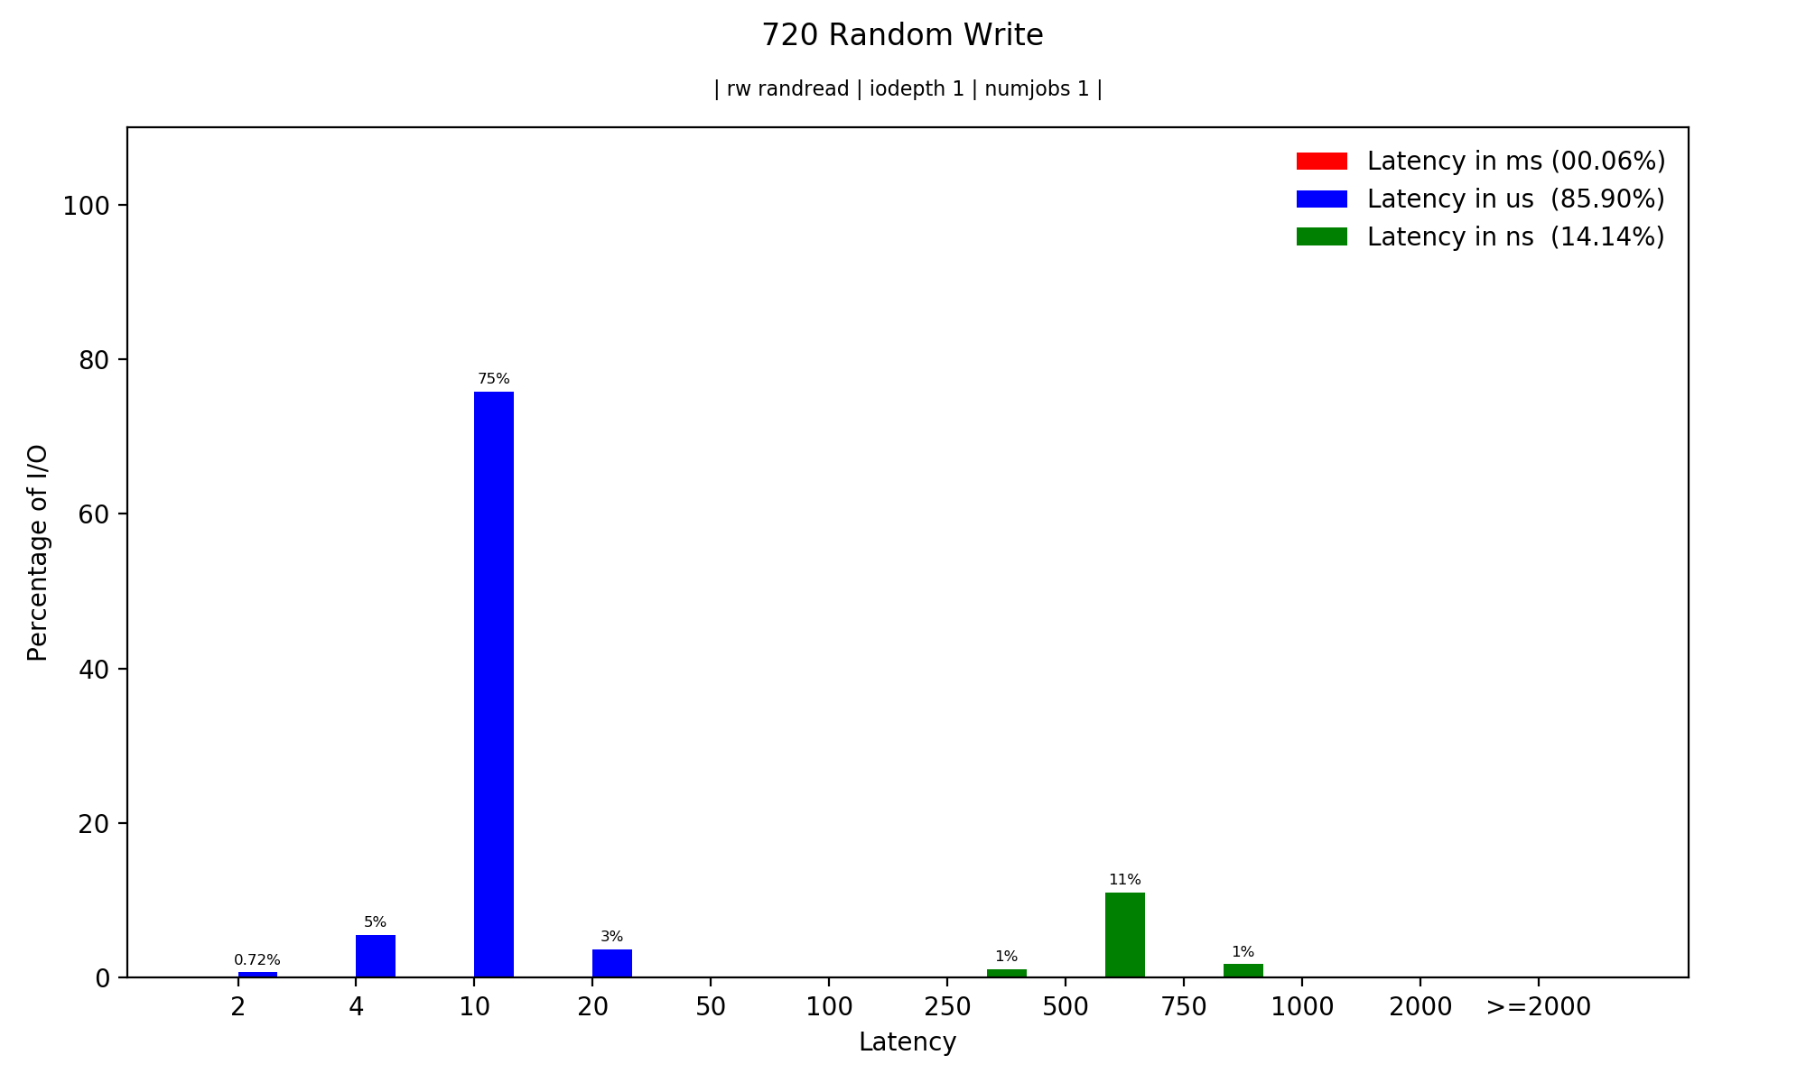
Figure 5: Understanding Latency and I/O percentage for a specific block size

Slide 8
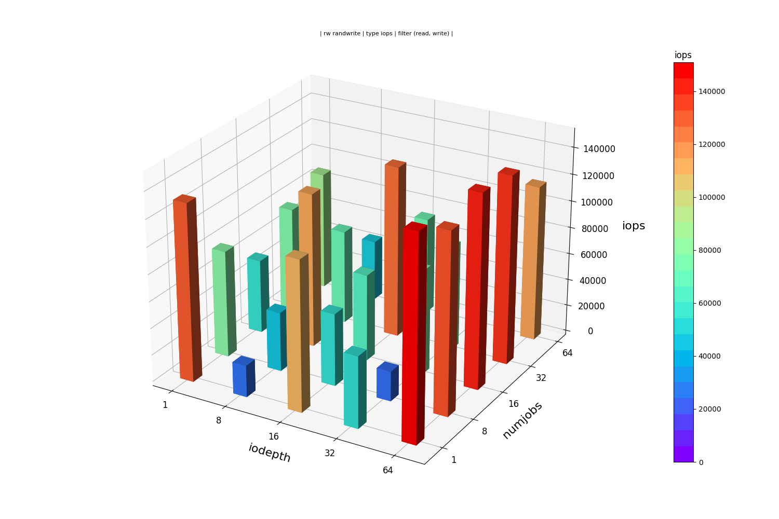
Figure 6: Visualizing IOPS and Latency benchmark

